Slide 1
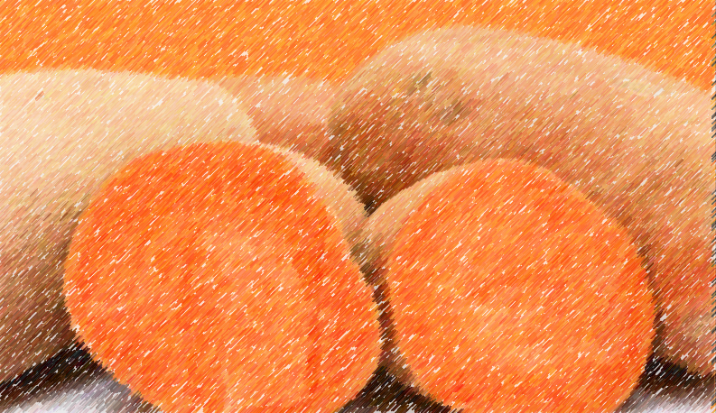
SWEET POTATO MARKETABLE YIELD PREDICTION APPLICATION

Slide 2
TEAM MEMBERS
OLAITAN SHARON(PL) - Data collection, inspection and comprehension of data, data cleaning and processing, model tuning and deployment
SAHEED OKIKIOLA – Data collection, contributions to the group
AFOLAYAN PEACE – Data collection, inspection and comprehension of data, model performance evaluation, preparation of slides
OKUNOLA HABEEB – Data collection
RAPHAEL – Data collection, contributions to the group

Slide 3
MOTIVATIONS
SOLUTIONS
Increase in popularity and consumption of sweet potatoes.
Inability to depict output of sweet potatoes planted.
Collecting data on sweet potatoes which are cheap and more nutritious.
Predict an approximate marketable yield of sweet potatoes planted.
AIM
Our aim is to create a machine learning project that predicts the marketable yield of orange-fleshed sweet potatoes and white-fleshed sweet potatoes.

Slide 4
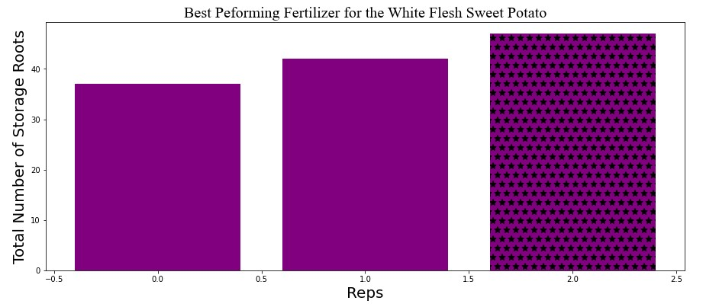
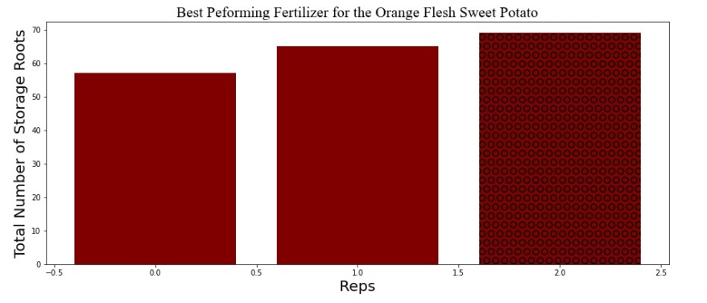
GRAPHICAL REPRESENTATION SHOWING THE DISTINCTION BETWEEN WHITE-FLESHED AND ORANGE-FLESHED SWEET POTATOES
WHITE-FLESHED
ORANGE-FLESHED

Slide 5
WORKFLOW IN DETAILS FEATURES USED FOR ANALYSIS
Location
Type of soil
Colour of the potato’s flesh
Fertilizer
Repetitions
Branches
Length of stem
Index of leaf area
Petoile length of leaf
Weight of adventitious root
Weight of the dry biomass
Total storage weight of the roots
Total weight of marketable roots
Total number of roots stored.

Slide 6
TARGET USED FOR ANALYSIS
Marketable Yield

Slide 7
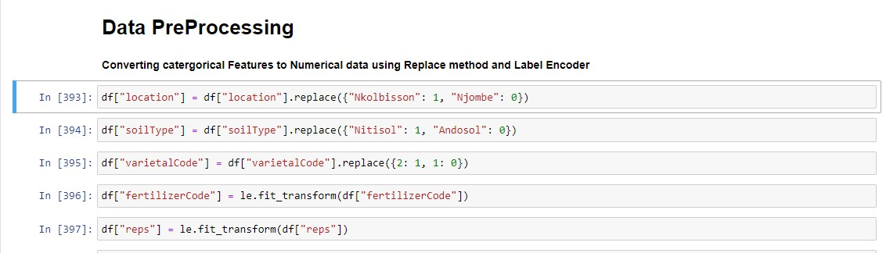
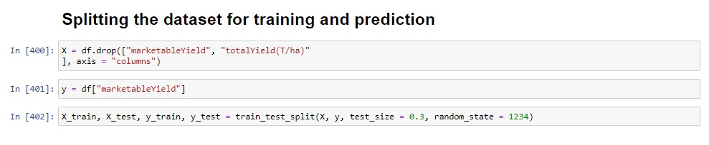
DATA PRE-PROCESSING AND SPLITTING

Slide 8
MODEL EVALUATION
MODEL | Mean Absolute Error | Mean Squared Error
Linear Regressor | 0.003 | 1.111
Gamma Regressor | 1.382 | 4.185
Huber Regressor | 0.053 | 0.004
Passive Aggressive | 0.750 | 0.820
Poisson Regressor | 1.236 | 0.820
Quantile Regressor | 4.088 | 2.576
RANSAC Regressor | 0.003 | 34.47
TheilSen Regressor | 0.003 | 1.092
Tweedie Regressor | 0.576 | 0.446
AdaBoost Regressor | 0.511 | 0.443

Slide 9
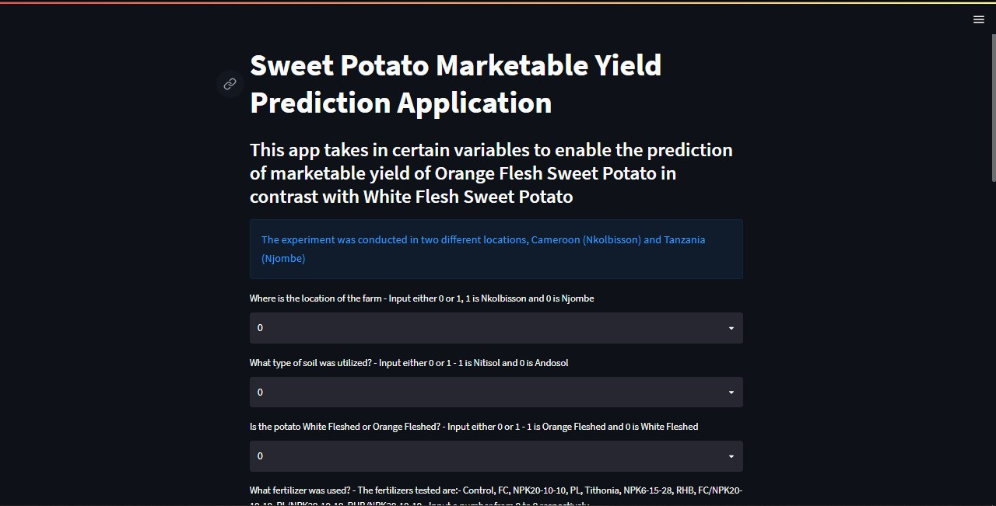
MODEL DEPLOYMENT

Slide 10
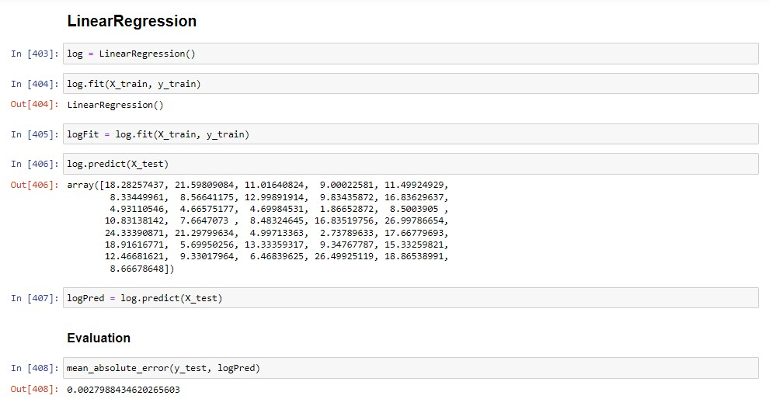
CONCLUSION
After the evaluation of all models, the Linear Regression Model was selected for tuning and deployment:

Slide 11
THANK YOU FOR LISTENING

